Slide 1

LLM-Based Predictive Modeling for Traffic Flow Optimization Using Real-Time Social Media Data
MCA In-House Project – First Review
Priom Dutta (24MCA0169) 3rd Semester
Guide: Dr. Tapan Kumar Das
Department of Smart Computing, Vellore Institute of Technology

Slide 2
Contents
Sl. No. | Title
1 | Introduction
2 | Why Large Language Models(LLMs)
3 | Problem Statement
4 | Objectives
5 | What’s missing in current Traffic Prediction?
6 | Scope of Project
7 | Proposed System Overview
8 | Proposed System Architecture
9 | UML Use-case diagram
10 | UML Class diagram
11 | Process flow
12 | Methodology
13 | Findings from Literature
14 | Conclusion

Slide 3
Introduction
Urban traffic congestion causes delays, fuel wastage and environmental impact.
Traditional methods (sensors, GPS, cameras) are costly and often fail to capture sudden incidents.
Social media platforms (e.g., X/Twitter) provide real-time, crowd-sourced traffic updates.
Large Language Models (LLMs) can analyze unstructured text, extract semantic meaning ,and identify traffic related events.
This project proposes an LLM-based predictive modeling framework using real-time social media data for traffic flow optimization in Vellore.

Slide 4

Why Large Language Models(LLMs) ?
Natural Language Understanding
LLMs excel at interpreting and generating natural language, making them ideal for extracting insights from unstructured
social media about traffic conditions
Multi-modal Data Infusion
They can seamlessly integrate
text, sensor data, and spatial-
Temporal information to generate
Comprehensive predictive insights.
.
Recent studies demonstrate that LLMs provide interpretable and accurate traffic flow predictions, often surpassing traditional deep learning methods.

Slide 5
Problem Statement
Urban traffic congestion causes significant delays, fuel wastage, and environmental harm. While existing monitoring systems such as sensors, GPS devices, and cameras provide structured traffic data, they are costly and often fail to capture sudden, localized incidents like accidents or road closures. On the other hand, social media platforms such as X (formerly Twitter) offer real-time, user-generated updates about traffic conditions, but this information is highly unstructured and noisy, making it difficult to extract useful insights. Large Language Models (LLMs) have the potential to process such data effectively, but their application in predictive traffic modeling, especially in medium-sized cities like Vellore, remains underexplored. This research addresses the challenge of developing an LLM-driven framework to analyze social media data for forecasting congestion and improving real-time traffic management.

Slide 6
Objectives
Develop an LLM-based framework capable of extracting accurate and meaningful traffic insights from noisy, unstructured social media posts, addressing the limitations of traditional sensor-based systems.
Design and implement a predictive modeling approach that forecasts congestion levels, accidents, and delays in real time for medium-sized cities like Vellore, enabling proactive traffic management.
Create an interactive visualization dashboard that delivers real-time alerts, heatmaps, and trend analysis, helping authorities and commuters make informed travel decisions.

Slide 7
What’s Missing in Current Traffic Prediction?
Existing traffic monitoring systems (sensors, GPS, cameras) are costly and often fail to capture sudden, localized events.
Social media provides real-time, crowd-sourced traffic updates, but the data is unstructured, noisy, and context-dependent.
Current research in traffic prediction focuses heavily on structured datasets and graph/deep learning models, with limited use of LLMs for unstructured text.
Most studies are concentrated on large metropolitan cities, leaving medium-sized cities like Vellore underexplored.
There is a lack of integrated frameworks that combine LLM-based text analysis with predictive modeling for real-time traffic flow optimization.

Slide 8
Scope of Project
Focuses on predicting traffic flow in Vellore using real-time social media data (tweets from X/Twitter).
Considers only English-language posts, with geotagging or text-based location inference to filter relevant traffic events.
Covers data preprocessing, semantic embedding generation (using lightweight LLMs like BERT/DistilBERT), and predictive modeling with ML/DL techniques (e.g., LSTM, XGBoost).
Results will be presented through a dashboard interface showing congestion levels (optional : heatmaps and alerts).
Once validated in Vellore, the framework can be extended to other medium-sized South Indian cities such as Mysuru, Trichy, Tirupati, Warangal, etc making it a scalable traffic management solution.

Slide 9
Proposed System Overview
The system leverages real-time social media data (tweets) to predict traffic flow and congestion levels.
A modular pipeline processes raw tweets: data collection → preprocessing → embedding generation → predictive modeling → visualization.
Lightweight LLMs (e.g., BERT, DistilBERT) convert unstructured text into semantic embeddings enriched with timestamp and location.
These embeddings are fed into ML/DL models (e.g., LSTM, XGBoost) to forecast congestion, delay categories, or incident likelihood.
The final outputs are presented through a dashboard with real-time alerts, traffic heatmaps, and trends for easy interpretation by commuters or authorities.
Designed to be scalable, initially for Vellore and extendable to other medium-sized South Indian cities.

Slide 10
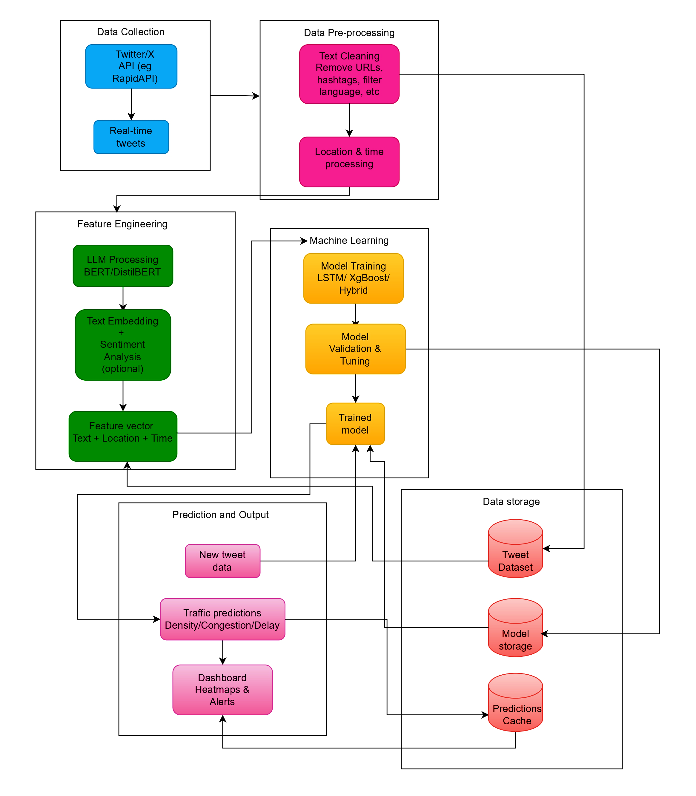
Proposed System Architecture

Slide 11
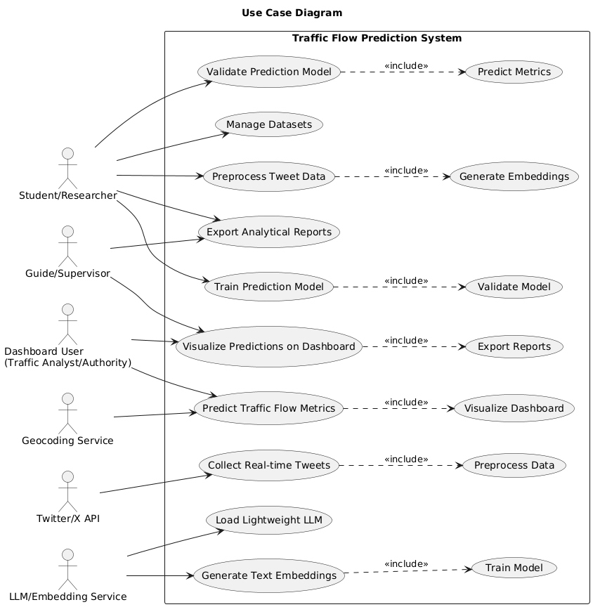
UML Use-Case diagram

Slide 12
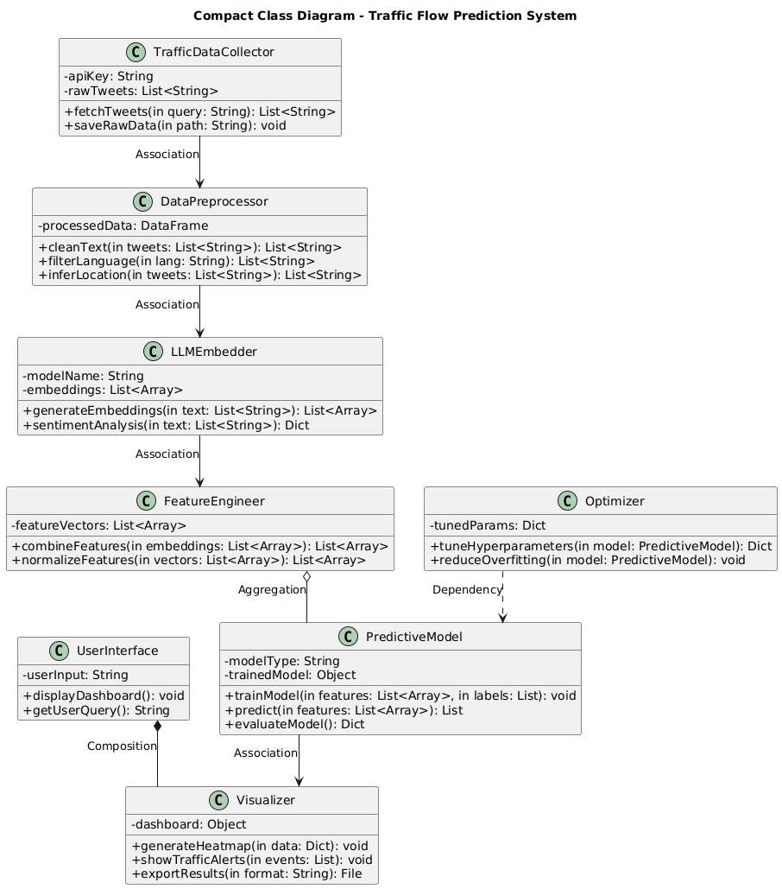
UML Class Diagram

Slide 13
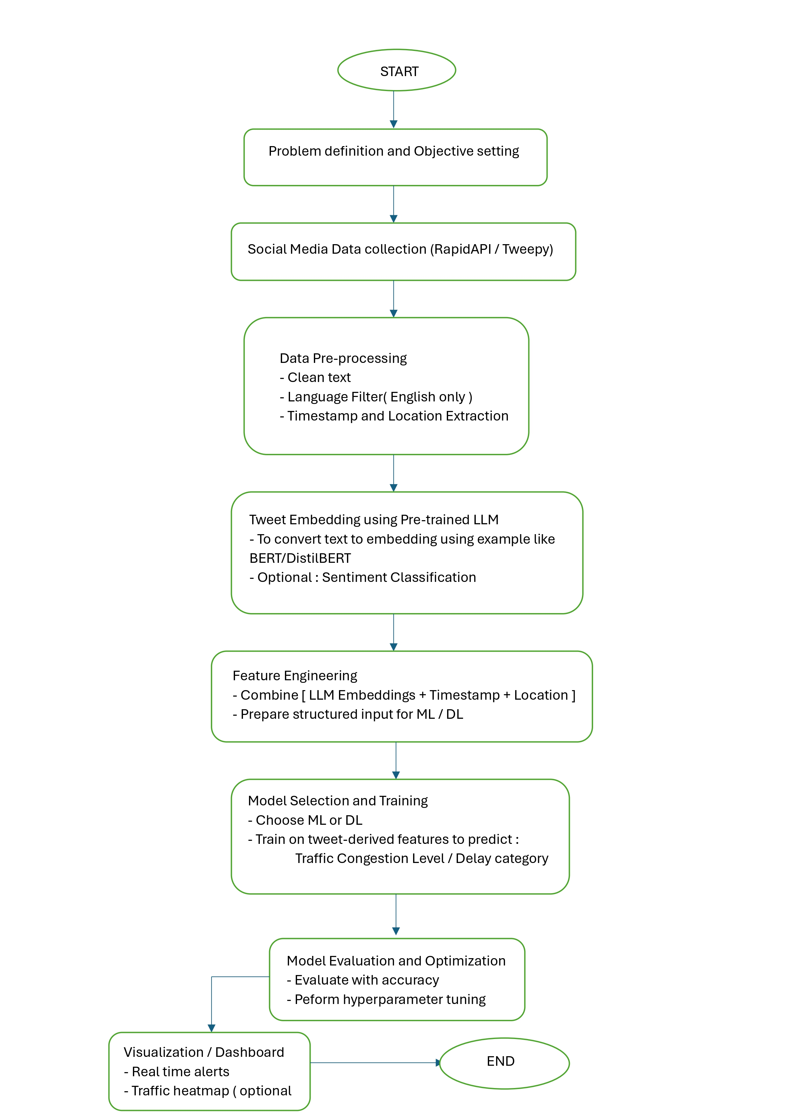
Process flow
Problem Definition & Objective Setting.
Define traffic congestion issues and
research objectives.
Data Collection
Gather real-time tweets using APIs (Tweepy/ Rapid API)
Data Preprocessing
Clean text, filter English tweets, extra -act timestamp & location
Tweet Embedding (LLM-based)
Convert tweets into semantic embeddi -ings (BERT/ DistilBERT).
Optional : sentiment classification
Feature Engineering
Combine embeddings with temporal & spatial features.
Model Training
Apply ML/DL models (e.g. XGBoost, LSTM)
Evaluation & Optimization
Measure accuracy, RMSE, F1-score
Perform hyperparameter tuning
Visualization & Dashboard
Display alerts, congestion maps and trends.

Slide 14
Methodology
Data Collection and Dataset Preparation
Objective : To gather real-time, location-specific traffic-related tweets that reflect congestion, accidents, or disruptions. This stage ensures the project captures dynamic, user-reported traffic updates beyond traditional sensor-based data.
Techniques: Use keyword-based filtering (e.g., “traffic jam,” “accident,” “roadblock”) and geolocation filters to target posts relevant to Vellore. Metadata such as time of posting and user geotags will also be collected.
Data Sources : X (formerly Twitter) API accessed through Tweepy or RapidAPI, restricted to public tweets.
Output : A raw dataset (initially 1000 –1500 tweets) including tweet text, timestamps, and available location information.

Slide 15
Methodology (contd….)
Dataset Preprocessing
Objective: To clean and standardize unstructured tweet text so that it can be effectively processed by downstream models. This reduces noise and improves the quality of learning.
Techniques: Removal of URLs, hashtags, mentions, emojis, and special characters; tokenization; stopword removal; text normalization (lowercasing, stemming/lemmatization). Location inference will be performed using geotags or Named Entity Recognition for place names.
Output: A structured dataset where each tweet has cleaned text plus essential metadata (time, location).

Slide 16
Methodology (contd….)
Feature Engineering with LLMs
Objective: To transform raw text into dense, meaningful numeric representations that capture semantic meaning, contextual clues, and relationships between words.
Techniques: Pre-trained Large Language Models (e.g., BERT, DistilBERT) will generate embeddings. These embeddings will then be combined with temporal features (time of day, day of week) and spatial features (location coordinates, region). Optional sentiment classification may be applied to capture severity of incidents.
Output: High-dimensional feature vectors that encode both the linguistic content of tweets and contextual metadata.

Slide 17
Methodology (contd….)
Model Development
Objective: To train predictive models capable of forecasting congestion levels, delay categories, or incident likelihood based on embeddings and contextual data.
Techniques:
LSTM models to capture sequential and temporal dependencies.
XGBoost or Random Forests to handle structured embedding + metadata features.
Hybrid architectures combining LLM embeddings with temporal models for improved accuracy.
Output: A trained prediction model capable of generating real-time traffic forecasts.

Slide 18
Methodology (contd….)
Model Evaluation and Optimization
Objective: To ensure the reliability, accuracy, and robustness of the developed prediction model
Metrics: Accuracy, Precision, Recall, F1-score (for classification tasks) and RMSE (for numeric predictions).
Techniques: Apply cross-validation to avoid overfitting and improve generalizability. Use hyperparameter tuning (grid search, learning rate adjustments, hidden layers, embedding dimensions) to refine model performance.
Output: An optimized and validated prediction model with clear performance benchmarks.

Slide 19
Methodology (contd….)
Visualization and Output
Objective: To deliver actionable traffic insights in a simple, user-friendly format suitable for both commuters and authorities.
Techniques: Build an interactive dashboard that displays real-time alerts, congestion heatmaps, traffic timelines, and incident notifications.
Output: A prototype dashboard that presents predictions visually, enabling smarter and faster decision-making for traffic flow management.

Slide 20

Findings from Literature
Towards Explainable Traffic Flow Prediction with LLMs ( Guo X et al., 2024 )
✅ Provides explainability by converting complex traffic data into natural language.
❌ Limited discussion on scalability; high computational cost and risk of overfitting.
Traffic Flow Prediction for Smart Traffic Lights ( Navarro A et al., 2022 )
✅ Evaluates multiple ML/DL models; MLP-NN achieves strong performance (R² = 0.93).
❌ Dataset limited to 56 days; does not address adaptive control in real-world systems.
Big Data Analytics in Intelligent Transportation Systems ( Zhu et al., 2018 )
✅ Comprehensive survey of big data sources and processing in ITS.
❌ Theoretical focus; lacks case studies and ignores data privacy/security iss
Real-Time Traffic Prediction Using Social Media Text + DL ( Mounica B et al., 2022 )
✅ Uses Twitter + Spark/Kafka for scalable real-time traffic prediction.
❌ Heavy reliance on Twitter data; ignores integration with official systems.
Traffic Prediction Using Time-Space Diagram (CNN) ( Khajeh M et al., 2019 )
✅ CNN outperforms ARIMA, SVR, MLP for flow and density prediction.
❌ Computationally intensive; requires connected vehicle data (not always available).
AI-Based Traffic Flow Prediction (Sayed S.A. et al., 2023 )
✅ Comprehensive review of ML/DL techniques and challenges.
❌ Theoretical; lacks practical implementations and ignores data privacy/security.

Slide 21
Conclusion
In Urban congestion remains a major challenge that cannot be fully solved by existing sensor or GPS-based systems.
Social media offers real-time, crowd-sourced traffic updates, but this data is noisy and unstructured. By applying LLM embeddings, the system can extract semantic meaning, identify traffic-related events, and capture temporal-spatial context from tweets.
Integrating LLM features with ML/DL models (LSTM, XGBoost) enables accurate forecasting of congestion levels, accidents, and delays. This hybrid pipeline provides both predictive power and adaptability for medium-sized cities like Vellore.
Future Scope: Evolve into a city-wide intelligent transport assistant by integrating heterogeneous data sources (IoT sensors, GPS feeds, CCTV), enabling real-time traffic control, adaptive signal management, and AI-driven smart city mobility planning.

Slide 22
References
[1] Guo, X., Zhang, Q., Jiang, J., Peng, M., Zhu, M., & Yang, H. F. (2024). Towards explainable traffic flow prediction with large language models. Communications in Transportation Research, 4, 100150.
[2] Navarro-Espinoza, A., López-Bonilla, O. R., García-Guerrero, E. E., Tlelo-Cuautle, E., López-Mancilla, D., Hernández-Mejía, C., & Inzunza-González, E. (2022). Traffic flow prediction for smart traffic lights using machine learning algorithms. Technologies, 10(1), 5.
[3] Zhu, L., Yu, F. R., Wang, Y., Ning, B., & Tang, T. (2018). Big data analytics in intelligent transportation systems: A survey. IEEE transactions on intelligent transportation systems, 20(1), 383-398.
[4] Mounica, B., & Lavanya, K. (2022). Real time traffic prediction based on social media text data using deep learning. Journal of mobile multimedia, 18(2), 373-391.
[5] Khajeh Hosseini, M., & Talebpour, A. (2019). Traffic prediction using time-space diagram: a convolutional neural network approach. Transportation Research Record, 2673(7), 425-435.
[6] Sayed, S. A., Abdel-Hamid, Y., & Hefny, H. A. (2023). Artificial intelligence-based traffic flow prediction: a comprehensive review. Journal of Electrical Systems and Information Technology, 10(1), 13.

Slide 23
References (contd….)
[7] Fan, Y., Yeh, C. C. M., Chen, H., Wang, L., Zhuang, Z., Wang, J., ... & Zhang, W. (2023, September). Spatial-temporal graph sandwich transformer for traffic flow forecasting. In Joint European Conference on Machine Learning and Knowledge Discovery in Databases (pp. 210-225). Cham: Springer Nature Switzerland.
[8] Yu, B., Yin, H., & Zhu, Z. (2017). Spatio-temporal graph convolutional networks: A deep learning framework for traffic forecasting. arXiv preprint arXiv:1709.04875.
[9] Cui, Z., Henrickson, K., Ke, R., & Wang, Y. (2019). Traffic graph convolutional recurrent neural network: A deep learning framework for network-scale traffic learning and forecasting. IEEE Transactions on Intelligent Transportation Systems, 21(11), 4883-4894.
[10] Masri, S., Ashqar, H. I., & Elhenawy, M. (2025). Large language models (llms) as traffic control systems at urban intersections: A new paradigm. Vehicles, 7(1), 11.

Slide 24
References (contd….)
[11] Ahmed, S. F., Kuldeep, S. A., Rafa, S. J., Fazal, J., Hoque, M., Liu, G., & Gandomi, A. H. (2024). Enhancement of traffic forecasting through graph neural network-based information fusion techniques. Information Fusion, 110, 102466.
[12] Wang, Y., He, Z., & Hu, J. (2020). Traffic information mining from social media based on the MC-LSTM-Conv model. IEEE Transactions on Intelligent Transportation Systems, 23(2), 1132-1144.
[13] Zhang, M., & Zhao, W. (2025). Traffic Flow Prediction Based on Large Language Models and Future Development Directions. In ITM Web of Conferences (Vol. 70, p. 01008). EDP Sciences.
[14] Zhao, Y., Luo, X., Wen, H., Xiao, Z., Ju, W., & Zhang, M. (2024). Embracing large language models in traffic flow forecasting. arXiv preprint arXiv:2412.12201.
[15] Melhem, W., Abdi, A., & Meziane, F. (2024, November). Traffic Detection and Forecasting from Social Media Data Using a Deep Learning-Based Model, Linguistic Knowledge, Large Language Models, and Knowledge Graphs. In 16th International Joint Conference on Knowledge Discovery, Knowledge Engineering and Knowledge Management. 92277.

Slide 25
THANK YOU

